Slide 1
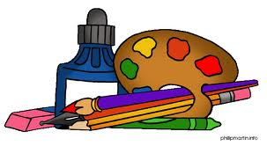
Arts in Healthcare
By: Chris, Mike & Meg

Slide 2
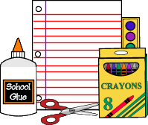
About our project…
We decided to combine literature with a creative element to make newspaper-like headlines.

Slide 3
How did we do it?
We cut out words and categorized them by parts of speech: verbs, nouns, people of interest, etc. We encouraged patients and relatives/friends of patients to participate. Each participant selected words to create their own “headline” and pinned them onto a tri-fold board. The exercise was meant to create an engaging activity for patients and relatives/friends that would keep their minds occupied with something other than their current situation

Slide 4
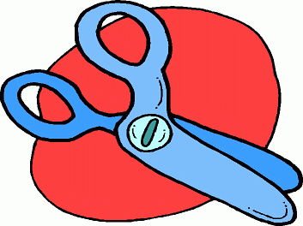
Our interactions/personal experience
We each had the opportunity to talk one-on-one with a patient or relative/friend of a patient
We familiarized ourselves quickly with those we spoke to and soon had conversations about things other than the current activity

Slide 5
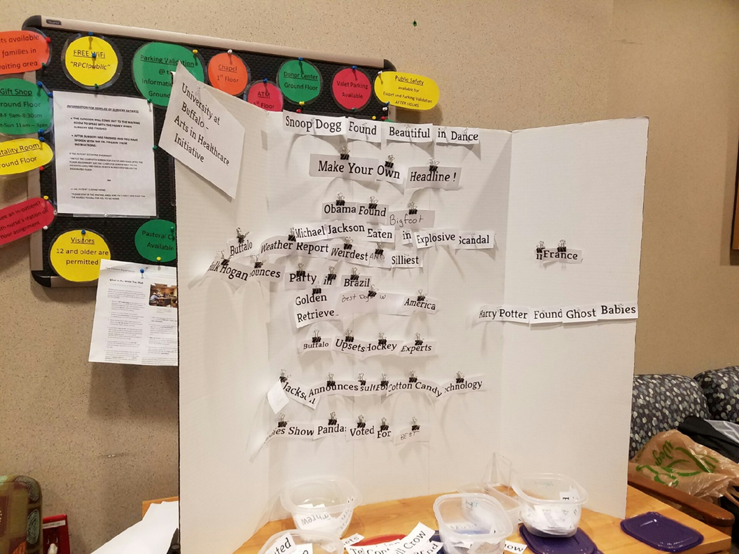
The final result

Slide 6
Reflection
Our favorite parts of the project…
What we learned…
How we will use this for further experiences…

